Slide 1
Common Ear Conditions
AHAD 1
Gabrielle Heil, MN, NP
Sept 17, 2026

Slide 2
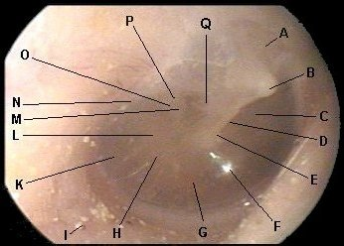
Normal Tympanic Membrane Anatomy
Notes:
A – Pars flaccida
B – Short process of malleus
C – Pars Tensa (anterior superior quadrant)
D – Manubrium of malleus
E – Umbo
F – Light reflex
G – Pars Tensa (anterior inferior quadrant)
H – Promontory of cochlea
I – Grains of sand
K – Round window niche
L – Pars Tensa (posterior inferior quadrant)
M – Incus (lenticular process)
N – Chorda tympani
O – Incudostapedial joint
P – Incus (long process)
Q – Pars Tensa (posterior superior quardrant)
https://www.pediatrics.wisc.edu/education/acute-otitis-media/tympanic-membrane-anatomy/

Slide 3
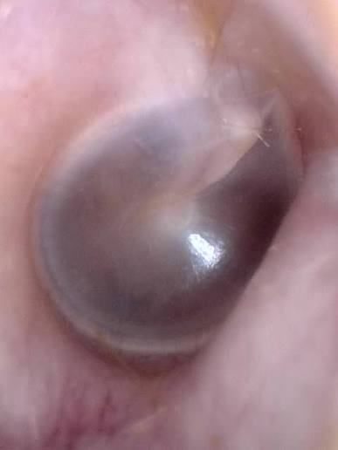
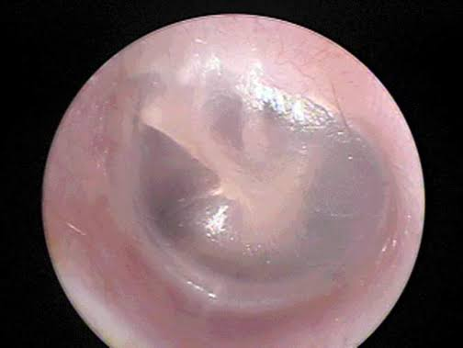

Slide 4
Acute Otitis Media (AOM)
Definition:
Risks:
Symptoms:
Signs:
Physical Examinations:
Confirmatory Diagnostics:

Slide 5
Acute Otitis Media (AOM)
Definition: infection of the middle ear (media = middle)
Risks: <6 years old, smoke exposure, recent URI
Symptoms: pain is unilateral (usually), deep or blocked feeling; sleep interference possible; hearing difficulty & possible tinnitus or dizziness (esp. in children)
  For infants: crying with sucking, fussiness when lying down (increased vascular pressure = TM bulge)
Signs:
Physical Examinations:
  Visual inspection (otoscope): discharge possible if TM rupture, myringitis (localized redness & inflammation of the TM), bulging TM, opaque TM, decreased/absent light reflex; decreased TM mobility
  Fever
  Swelling of preauricular node, sometimes in children
  Not associated with pain on pinna/auricle manipulation (this would be otitis externa)
Confirmatory Diagnostics: None

Slide 6
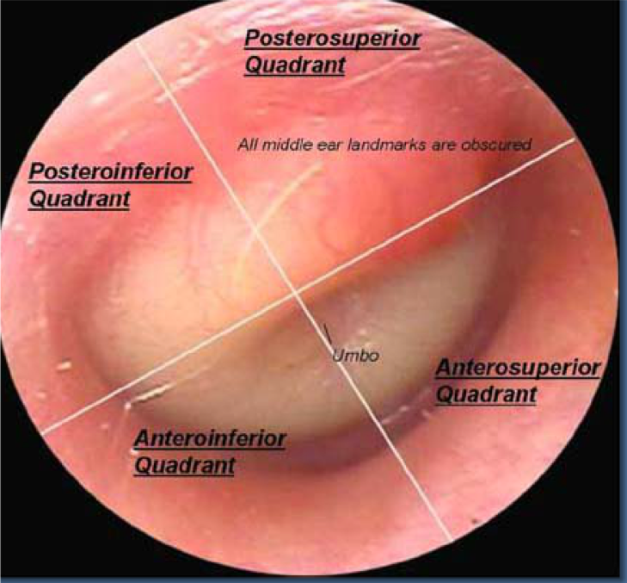

Slide 7
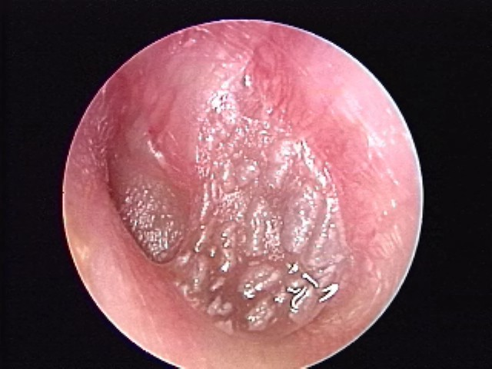
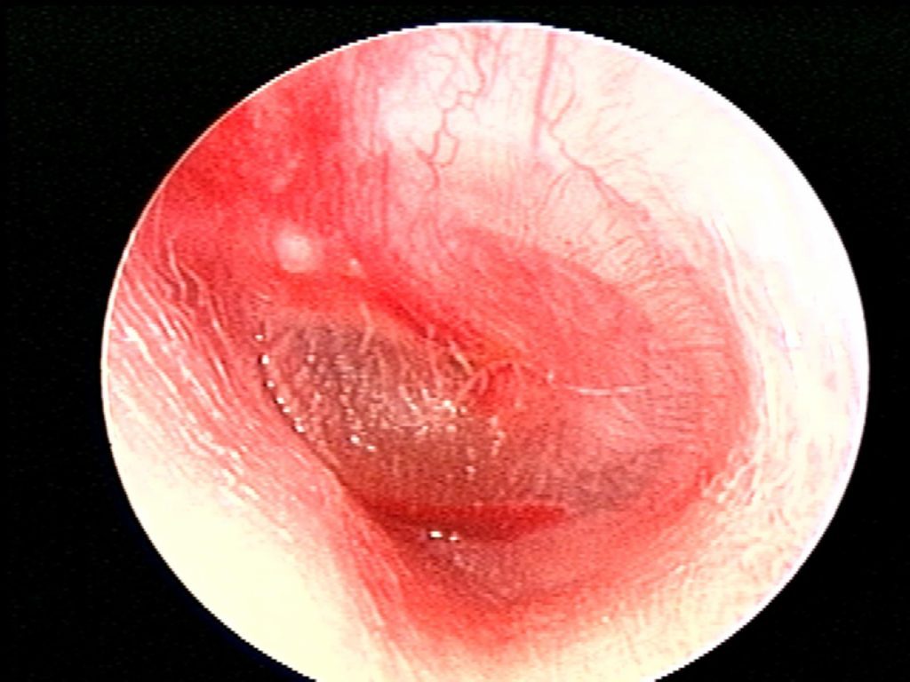
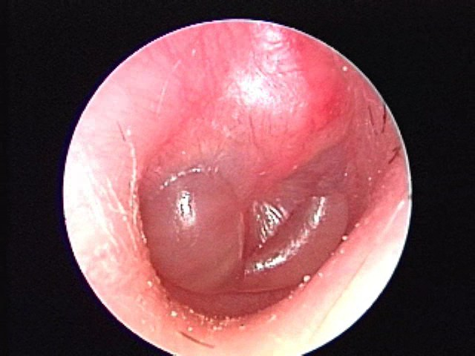
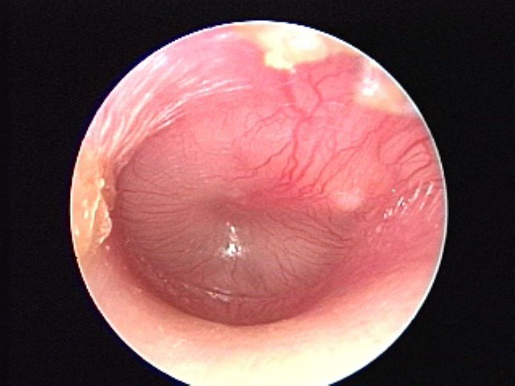
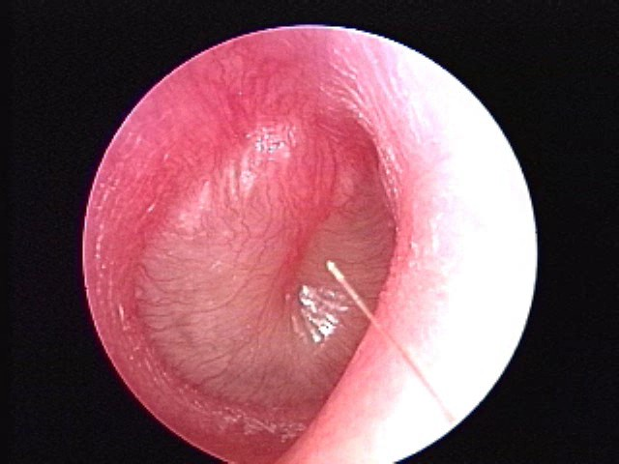
AOM with some cobblestoning with edema of tympanic membrane
Bullous AOM
Mild Bulging AOM
Severe Bulging AOM
Notes:
https://www.pediatrics.wisc.edu/education/acute-otitis-media/exercises/images/

Slide 8
Otitis Media with Effusion
Definition:
Risks:
Symptoms:
Signs:
Physical Examinations:
Confirmatory Diagnostics:

Slide 9
Otitis Media with Effusion
Definition: non-infected fluid behind the tympanic membrane (middle ear still)
Risks: children > adults; for adults it is more common after an URI
Symptoms: may follow a URI, unilateral, with crackling/bubbling/popping sensation
*no pain*
Signs:
Physical Examinations:
  Visual inspection (otoscope): collection of fluid (air bubbles, fluid level, mucous) observed behind TM, hearing loss, decreased TM mobility; TM may be injected (red lines)
Confirmatory Diagnostics: pneumatic otoscopy, tympanogram (likely will refer out to audiologist or ENT for this)
Notes:
This is not an ACUTE Otitis Media.
Fluid accumulation is the result of poor Eustachian tube ventilation (blockage), not purulent middle ear infection fluid.
It may FOLLOW an acute otitis media due to residual inflammation in the Eustachian tube

Slide 10
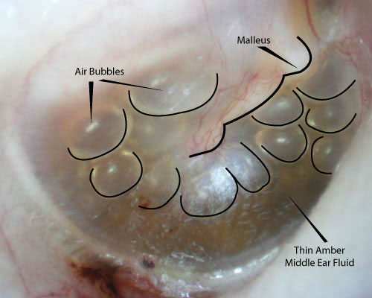
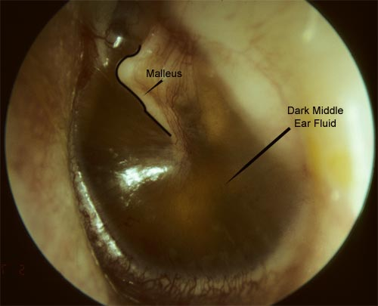
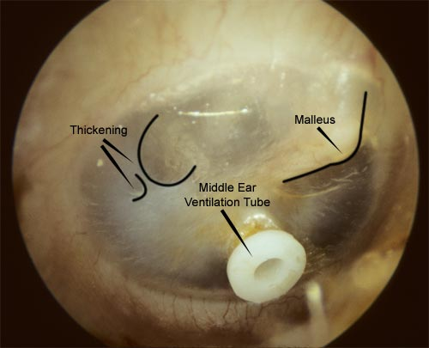
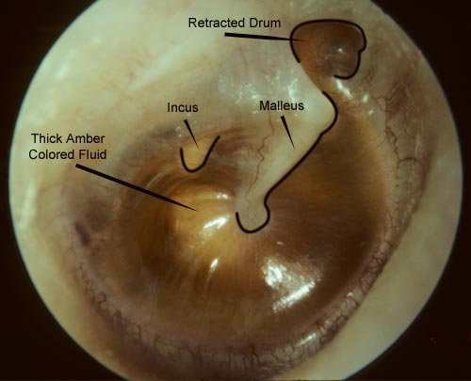
Notes:
https://med.uth.edu/orl/online-ear-disease-photo-book/chapter-4-fluid-in-the-ear/fluid-in-the-ear-images/

Slide 11
Otitis Externa (External Otitis)
Definition:
Risks:
Symptoms:
Signs:
Physical Examinations:
Confirmatory Diagnostics:

Slide 12
Otitis Externa
Definition: infection of the external ear canal (anything before the TM)
Risks: adults > children; swimmers, diabetes, ear pickers (Q-tips)
Symptoms: bilateral pain, stuffed ear, hearing loss (occasionally); may be associated with hx of swimming 1-2 days prior
Signs:
Physical Examinations:
  Visual Inspection (otoscope): inflamed, swollen external canal (canal may be swollen shut); discharge may be cheesy green-blue or grey; TM normal or not visible
  Pinna manipulation often causes ++ pain
  Enlarged preauricular or postauricular nodes
Confirmatory Diagnostics: none

Slide 13
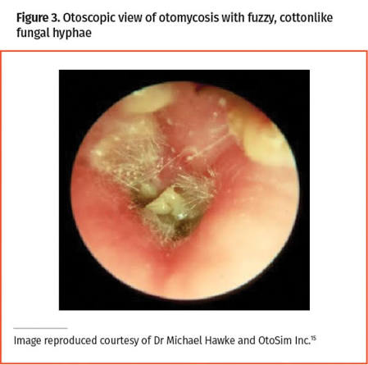
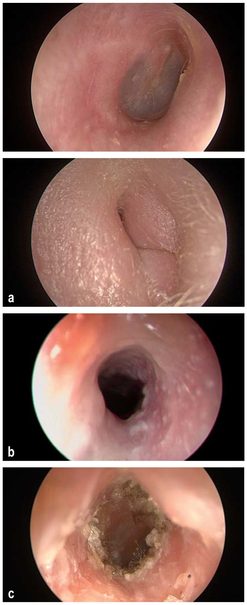
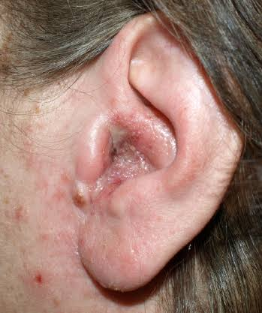
Notes:
a) Normal right external auditory canal, with view of the eardrum.
b) Swollen introitus of the right external auditory canal in a patient with acute otitis externa.
c) An external auditory canal affected by bacterial otitis externa.
d) Otomycosis

Slide 14
Let’s Differentiate Together!
Symptom | Acute Otitis Media | Otitis Media with Effusion | Otitis Externa
Pain
Hearing Loss
Bubbling/ Popping Sensation
Stuffed ear sensation
Children vs Adults

Slide 15
Let’s Differentiate Together!
Physical Exam | Acute Otitis Media | Otitis Media with Effusion | Otitis Externa
Fever
Tympanic Membrane
Fluid Level
Discharge
Lymph Nodes
Pinna Manipulation

Slide 16
Don’t Miss Diagnosis: Mastoiditis
Definition:
Risks:
Symptoms:
Signs:
Physical Examinations:
Confirmatory Diagnostics:

Slide 17
Mastoiditis
Definition: infection of the soft tissue surrounding the air spaces in the mastoid bone
Risks: associated with bacterial otitis media
Symptoms: chronic otitis, pain behind the ear
Signs:
Physical Examinations:
  Visual inspection reveals erythema & swelling
  Palpation of mastoid process reveals swelling & tenderness
  Vitals: fever
Confirmatory Diagnostics:
X-ray of the mastoid sinus
** If advanced, referral to ER for ? surgery
Notes:
What are the risks of missing this diagnosis?
- Can lead to osteomyelitis, meningitis, or brain abscess

Slide 18
Case Study #2
Beth (she/her), a 33-year-old early childhood educator, reports "excruciating pain in the left ear for the past 24 hours." She has no history of ear problems. The history reveals that she teaches swimming part-time for a competitive swim team at the local YMCA. She presents today because the pain is worsening, and she noticed white-to-yellowish drainage from her ear on her pillow this morning. She has no fever.
Questions — Case #2
At this stage, list the differential diagnoses the NP should consider based on Beth's presenting symptoms.
What physical findings would the NP expect to observe during the examination?
What is the most likely causative microorganism?
If the tympanic membrane could not be visualized, how should the NP rule out a middle ear infection?

Slide 19
Practice OSCE
Notes:
Including practicing physical examinations

